Slide 1
10/28/24 Update
Austin Neff, Kevin Nelson, Jordan Raver, Ben Siesser,
Sam Spencer, Yang Yang

Slide 2
Updates:
Alternative Generic Motor Driver Arrived
ROS2 Humble Setup on Orange Pi
Working on printing temporary test stand
Waiting on:
PWB Encoders
ODrive Motor Board
Meantime:
Working on understanding ROS2 CAN connection
Setting up ROS2 with ODrive libraries

Slide 3
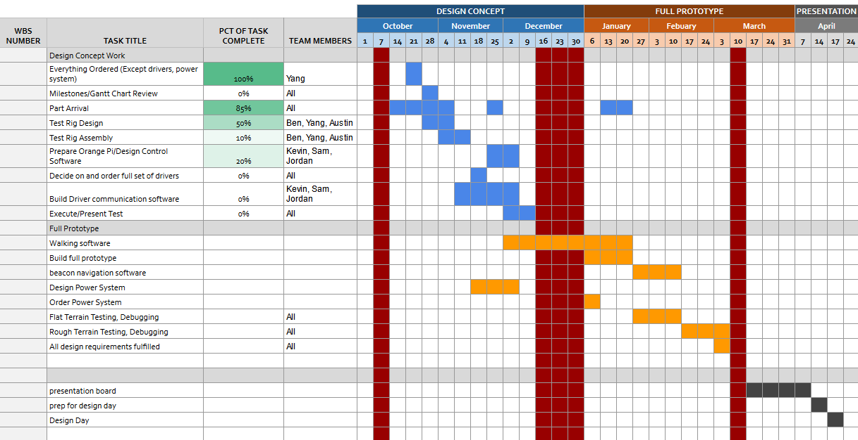
Current Plan: GANTT Chart

Slide 4
Ordering Totals:
Total Ordering Information from Purchasing Request Site
Vendor | Date | Subtotal
PWB Encoders | 9/21 | $1,245.77
Amazon | 9/28 | $134.74
Amazon | 9/30 | $9.99
123 Bearing | 9/30 | $382.61
Belting Online | 9/30 | $202.61
McMaster-Carr | 9/30 | $76.10
Amazon | 9/30 | $7.99
Digikey (Return in Progress) | 9/30 | $108.48
Amazon | 10/10 | $127.99
ODrive | 10/21 | $149.00
Bambu Lab | 10/21 | $69.98
Adafruit | 10/21 | $11.95
Digikey | 10/21 | $86.16
Amazon | 10/21 | $119.80
As of 10/25: | Total: | $2,632.19
Everything except for the rest of the motor drivers ordered
Awaiting ODrive Motor Board for conclusion
Final Cost Estimate w/ Untethered Power
w/ Power System Budget of | $1,000
w/ ODrive Controllers |  | $4,569.25
w/ Amazon Alternative Controllers |  | $3,764.18

Slide 5
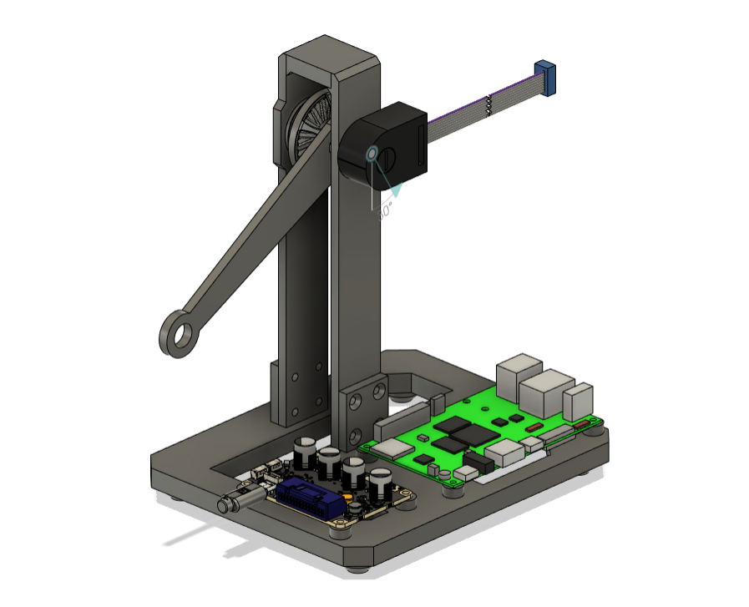
Robot Test Stand
Includes temporary encoder, motor driver board, Orange Pi 5
Waiting on temporary encoder to complete
Goal: Figuring out communication and controller board libraries plus measuring power draw

Slide 6
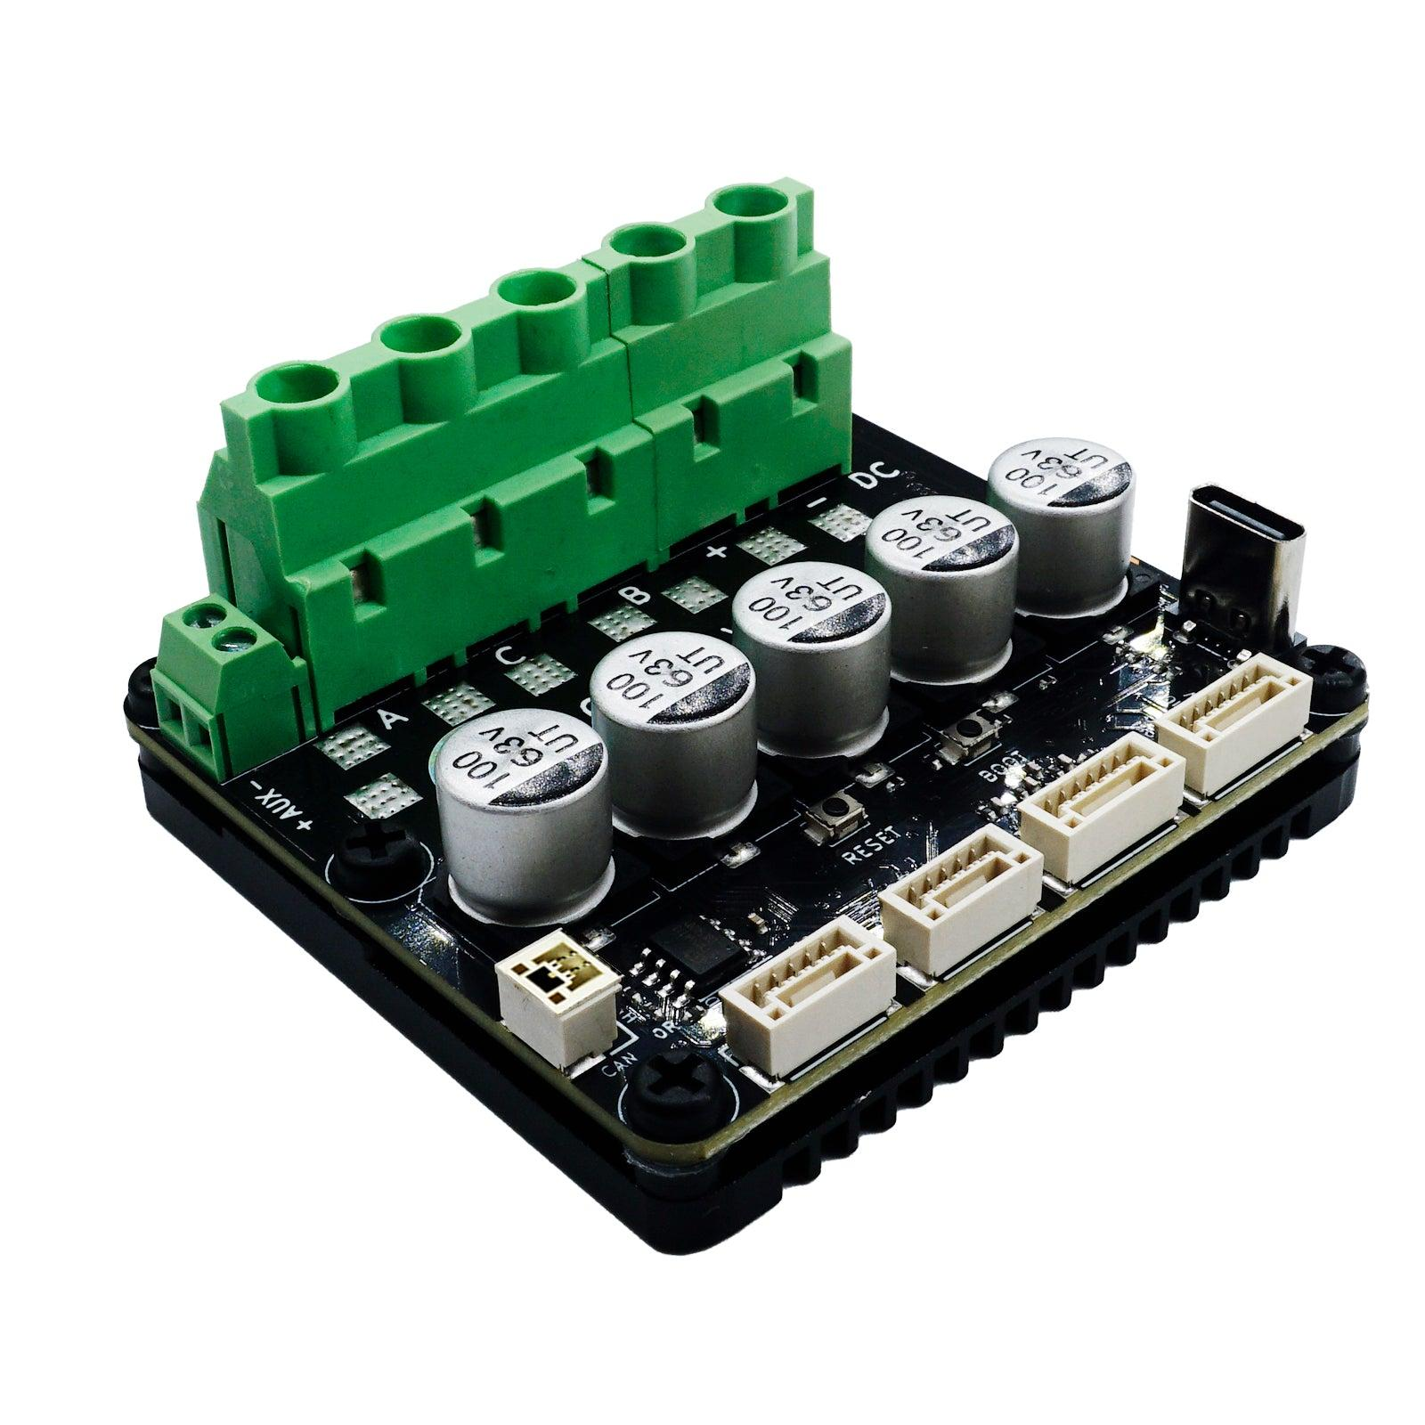
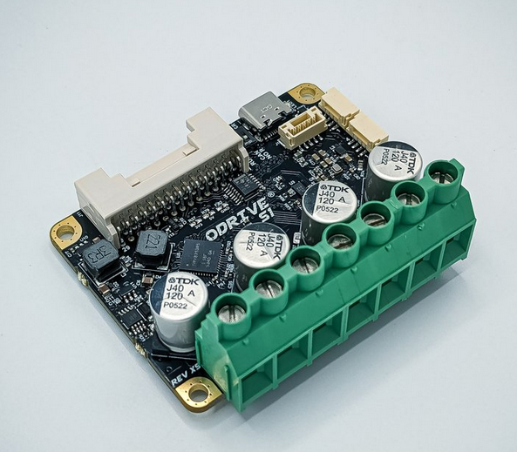
Motor Driver Options
Top: Generic ($33.99)
Bottom: ODrive S1 ($149) ($89 ODrive Micro is yet to release)
Both use ODrive’s documentation and library
ODrive S1 has much better documentation and community support
ODrive S1 has official CAN cable daisy chaining support

